Slide 1

Capstone Project-Boston Housing Data
Ashimabha Bose
PGD Data Science
Term1 - Business Analytics
May 2018 Batch

Slide 2
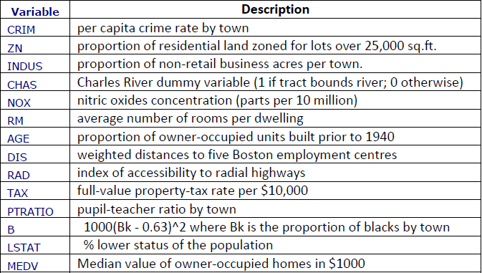
Problem Statement and Variable Description
Based on the following variable we have to predict the median value of owner occupied homes in the area of Boston.

Slide 3
Steps :
Data Importing and Checking
Data Visualization
Data Imputation
Correlation Check
Model Creation
Prediction

Slide 4
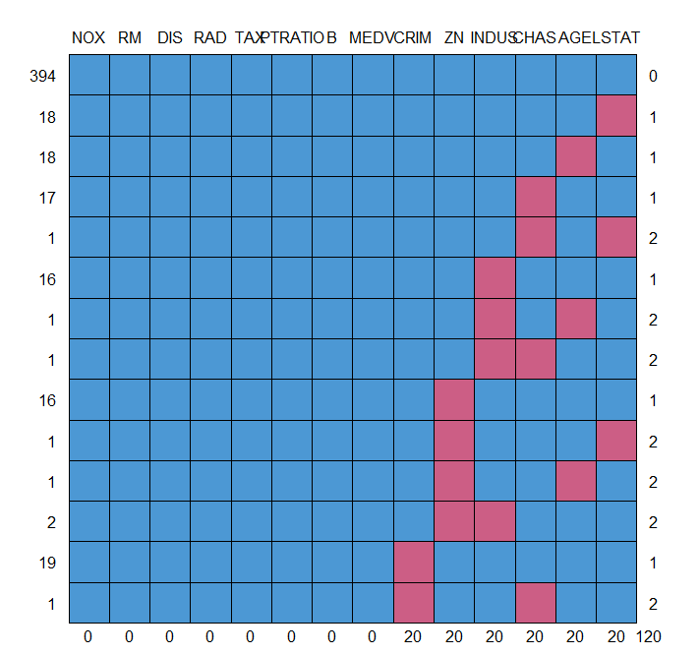
Data Importing and Checking
Data was imported from the saved location using read.csv function.
Summary of data is taken.
The data is numeric.
Mice package was used to check the summary as well as number of missing values in the data.
Adjacent figure represents the number of missing values in the variables.

Slide 5
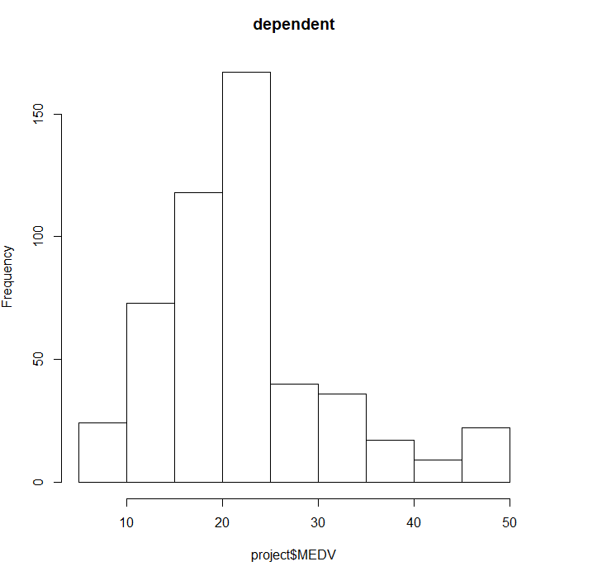
Data Visualization
Adjacent figure shows the histogram of dependent variable.
It indicates right skewness.
It can be normalized using natural logarithm while creating the model.

Slide 6
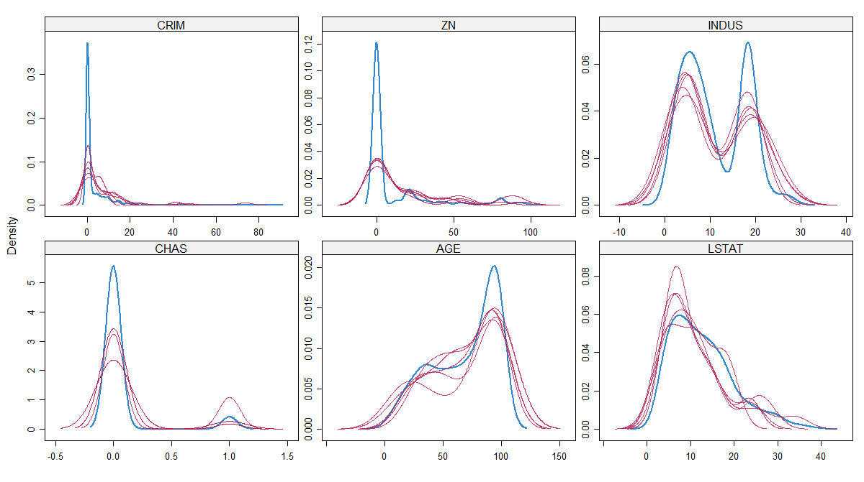
Data Imputation
From the mice library ‘pmm’ method was used to impute for the missing values
Pmm is predictive mean matching.
Iteration was done 5 times
Accuracy of predicted value was checked by the density plot.
Adjacent figure shows the accuracy with respect to the available values.

Slide 7
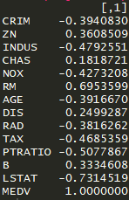
Correlation Check
Correlation among dependent variable and independent variable is checked.
We can see that LSTAT and the RM variable have the most correlation with the dependent variable.

Slide 8
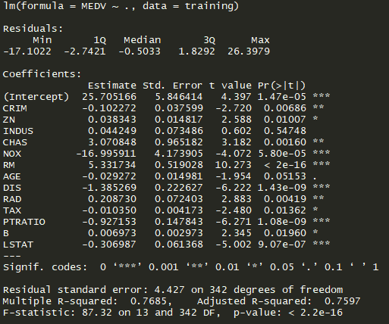

Model Creation
Natural logarithm of MEDV variable is taken.
Data partition was done in 70:30 ratio.
1st model was created considering all the variables.
Vif was checked.
Model 1 summary

Slide 9
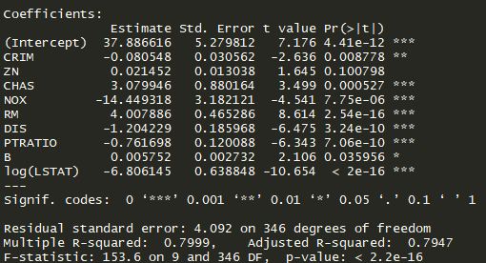
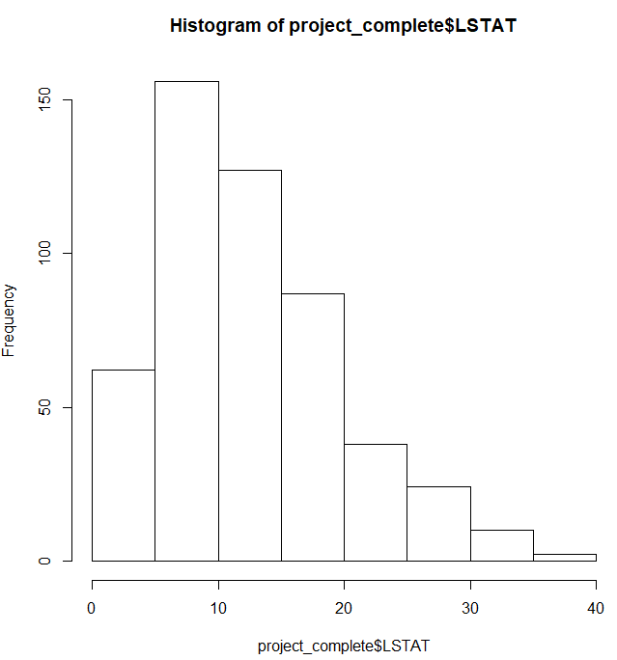
Model Creation – 2nd Model
In this model we have removed the insignificant variables as well as the TAX and RAD variable.
Also since LSTAT variable is right skewed as seen from the histogram. We have taken it’s natural logarithm.
Model 2 Summary

Slide 10

Prediction
The accuracy of the model is increased to .7999.
Although the second model has an insignificant variable.
We will go with this model as the ZN variable is important for predicting the house value.
Predicting the model on the testing data and comparing it with the recorded values.
From the adjacent figure we can see that the model is able to predict the values approximately to the recorded values.

Slide 11
THANK YOU

